Slide 1


ENIGMA
Information Security Systems
COMPANY PROFILE
CENTRE FOR THE DEVELOPMENT OF ADVANCED SECURITY TECHNOLOGIES
05.2022

Slide 2
Introductory information
Legal information
Group structure
Financial overview
Operational summary
Key clients
Product portfolio overview
History
Key products and markets
Products and services portfolio
Enigma SOI key sectors and segments
Intellectual Property
Intellectual property documentary evidence
Research & Development projects
Human resources
Management team
Human resources, key competences & experience
Clients and business partners

Slide 3


1. INTRODUCTORY INFORMATION
LEGAL INFORMATION
ENIGMA SOI – CENTRE FOR THE DEVELOPMENT OF ADVANCED SECURITY TECHNOLOGIES (INCLUDING CRYPTOGRAPHY) FULLY READY TO REALISE ITS SALES POTENTIAL
Full name
ENIGMA SYSTEMY OCHRONY INFORMACJI Sp. z o.o.
Enigma Information Security Systems LLC
Locations
Headquarters
JUTRZENKI 116, 02-230 WARSAW
Cencert Keys Certification Center
(Centrum Certyfikacji Kluczy Cencert)
Warsaw Headquarters
Ownership structure
100% COMP Inc. (S.A.)
Incorporation date
4 June 1993
REGON / NIP numbers
REGON: 011149535, NIP: 5261029614
Warsaw
Registered capital
28 718 500 PLN
Wroclaw
Management Board
Luksic Paweł – President of the Board
Wołoszyn Marek – Vice President
Ligenza Marcin – Vice President
Frydrych Radosław – Vice President
Wrocław Subsidiary
Supervisory Board
Morawski Krzysztof
Papaj Jacek
Wawer Andrzej
Cryptographic Equipment Manufacturing Plant

Slide 4









1. INTRODUCTORY INFORMATION
GROUP STRUCTURE
ENIGMA SOI IS FULLY OWNED BY COMP INCORPORATED (S.A.) LISTED ON WARSAW STOCK EXCHANGE
100%
100%
78.41%
52%
50.12%
Enigma SOI Sp. z o.o.
Warsaw
Polski System Korzyści Sp z o.o.
Warsaw
Elzab S.A.
Zabrze
Insoft Sp. z o.o.
Krakow
Comp Centrum Innowacji Sp. z o.o.
Warsaw
49.88%
JNJ Limited
67%
67%
Elzab Hellas
SPV Sp. z o.o.
92.18%
Micra Metripond KFT
Hungary
100%
Elzab
Hellas S.A.
50.46%
Comp Platforma Usług S.A.
Warsaw

Slide 5
1. INTRODUCTORY INFORMATION
OPERATIONAL SUMMARY
ENIGMA SOI OPERATIONS – INFORMATIVE CHARACTERISTICS
ENIGMA areas of activity
solutions in the field of security and protection of classified information,
creation and delivery of innovative technological solutions in the field of hardware and software,
Polish designer and manufacturer of cryptographic and electronic devices,
Designer and supplier of DataCenter class solutions,
widely understood ICT systems integration.
Ministry of the Interior (MWS) concession in the area of manufacturing and trading of products for military or police use specified in WT II - VIII and WT XI and WT XIII;
Almost 200 employees with authorization to access classified information
4 - Top secret access, including NATO-Top Secret, EU-Top Secret
70 - Secret access, including NATO-Secret, EU-Secret
123 - Confidential access, including NATO-Confidential, EU-Confidential
Two Data Processing Centres & production plant with secure construction and production environment;
Security sector-specific certificates : 1st Class Industrial Security Certificate PL, NATO and EU;
ISO 9001, ISO 27001, AQAP 2110, NCAGE certificates;
24/7/365 service centre and IT consultancy.
28 years of market presence (founded in 1993)
200 IT specialists
300+ employees overall
Almost 200 employees with authorization to access classified information
Polish security market leader with over 160 PLNm revenues

Slide 6














BUSINESS MODEL
ENIGMA SOI BUSINESS MODEL
Enigma SOI Products
Encryptors - IP, HSM - CompCrypt
PKI solutions
Authentication systems
AVISPON
Crisis Management System
ETA-MIL 1000P*
DELTA 1P*
ETA-VPN 100P*
ETA-MIL 100Z*
Centaur - Modular PKI platform
PEM-HEART - PKI utility software
Qualified electronic signature
APTO - Two-factor authentication system
SLASH A3 - Centralized Authentication System
IDM - Identity management system
Dedicated solutions
Electronic Monitoring System
Digital Archive System
Airport security gates
E-passport systems
Sectors of operation
Areas of activity
Public key infrastructure
Dedicated solutions
Public administration
Telecommunications
Manufacturing, Transport and Energy
Access security
Electronic monitoring
Uniformed services
Information security
Biometric solutions
Financial institutions
Others
Data encryption and identity authentication services
Note: P – confidential clause, Z – restricted clause, HSM – Hardware Security Module

Slide 7













































1. INTRODUCTORY INFORMATION
KEY CLIENTS
LEADING AND STABLE MARKET POSITION IN POLAND - SUMMARY
PUBLIC ADMINISTRATION
UNIFORMED SERVICES
FINANCIAL INSTITUTIONS
TELECOM
MANUFACTURING, TRANSPORT AND ENERGY
MEDIA
MSZ (Ministry of Foreign Affairs)
MC (Ministry of Digitization)
MSWiA (Ministry of Internal Affairs)
MF (Ministry of Finance)
MS (Ministry of Justice)
RCB (Government Centre for Security)
Prokuratura (Prosecutor's Office)
Kancelaria Sejmu (Chancellery of the Parliament)
NFZ (National Health Fund)
IPN (Institute of National Remembrance)
PWPW (Polish Security Printing Works)
Police
Polish Army
SKW (Military Counterintelligence)
Straż Graniczna (Border Guard)
Straż Ochrony Kolei (Railroad Security Service)
NBP
Societe Generale
Santander
UKNF
BZWBK (Santander)
Bank Pocztowy
BGK
UPC Polska
Orange
TP SA (Orange)
Netia
PGE Systems
Gaz System
PSE (Polish Power Grids)
Okecie Airport (Warsaw)
Poznan Airport
Modlin Airport
PKP
General Inspectorate of Road Transport
TVN
7

Slide 8

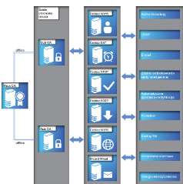
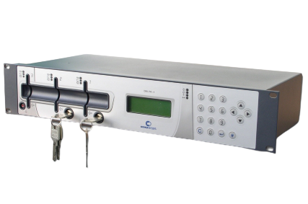
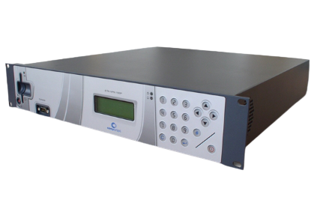
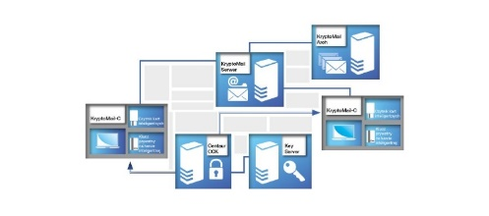
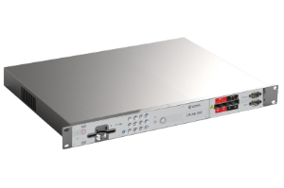
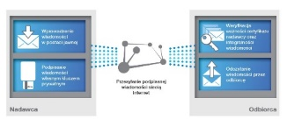
1. INTRODUCTORY INFORMATION
PRODUCT PORTFOLIO OVERVIEV
ENCRYPTORS & PUBLIC KEY INFRASTRUCTURE HARDWARE / SOFTWARE
CLASSIFIED INFORMATION PROTECTION
PUBLIC KEY INFRASTRUCTURE
CLASSIFIED SYSTEMS “CONFIDENTIAL” CLAUSE
CompCrypt ETA-MIL 1000P
CompCrypt Delta 1
CompCrypt ETA-VPN 100P
CLASSIFIED SYSTEMS “RESTRICTED” CLAUSE.
CompCrypt ETA-MIL 100 Z
Secure Mail System - based on certified solutions KryptoMail 3.1 and PEM-HEART 3.015
DEDICATED SYSTEMS
MODUL-BASED PKI PLATFORM
MODULES:
Centaur CCK
Centaur PR
Centaur OCSP
Centaur DAT
Centaur SCEP
Centaur WWW
SOFTWARE TOOL FOR THE IMPLEMENTATION OF PKI FUNCTIONS
MODULES: PEM-HEART Aplet, PEM-HEART API, PEM-HEART GUI, Encard Virtual
SECURE E-MAIL SYSTEM
MODULES: KryptoMail-C, KryptoMail Serwer, KryptoMail-Arch
QUALIFIED ELECTRONIC SIGNATURE

Slide 9

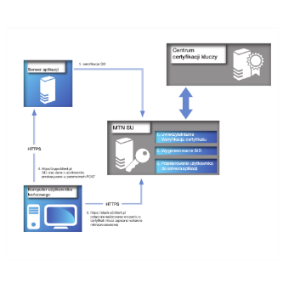
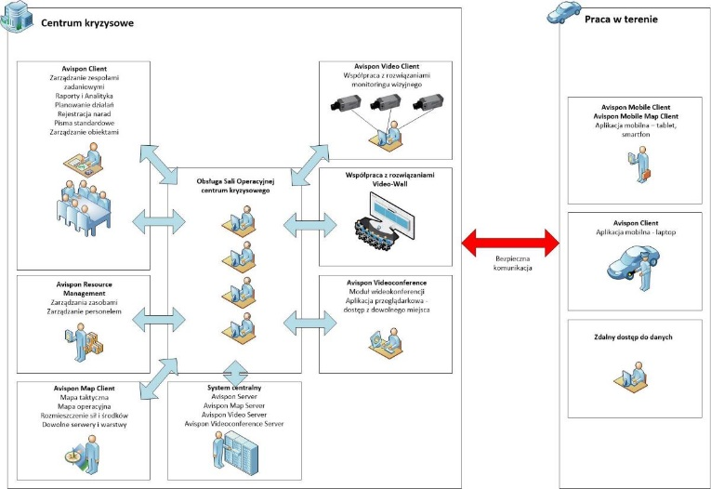
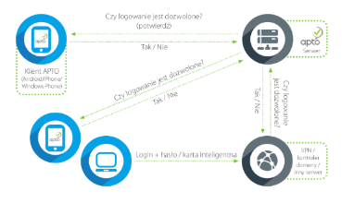



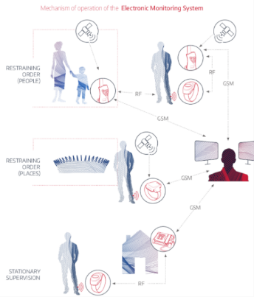
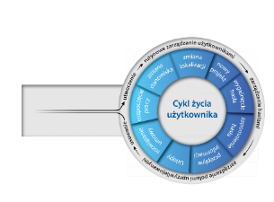
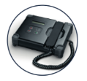
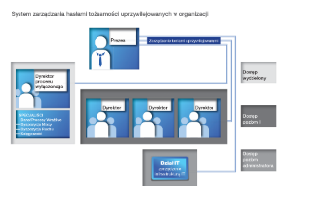



1. INTRODUCTORY INFORMATION
PRODUCT PORTFOLIO OVERVIEV
ADVANCED IN-HOUSE DEVELOPED PRODUCTS AND SOLUTIOND
ACCESS SECURITY
CRYSIS MANAGEMENT SYSTEMS
DEDICATED PRODUCTS
AND SOFTWARE
APTO – two-channel authentication system
SLASH A3 – central authentication system
IDM – identity management system
AVISPON SYSTEM
ELECTRONIC MONITORING SYSTEM (for Ministry Department of Justice);
e-PASSPORT SYSTEM (for Polish Security Printing Works)
DIGITAL ARCHIVE SYSTEM (for Institute of National Remembrance);
DATA RETENTION SYSTEM (for NETIA S.A.)

Slide 10




1. INTRODUCTORY INFORMATION
HISTORY
ENIGMA PROVIDES ITS ADVANCED SOLUTIONS TO MOST IMPORTANT GOVERNMENT BODIES AND COUNTRY STRATEGIC ENTITIES FOR OVER 28 YEARS
Establishment of Enigma Information Security Systems s.c.
Implementation of the first secure e-mail system for NASK.
Change of the company’s legal status into Enigma Information Security Systems Sp. z o.o.
Development and implementation of the NBP-HEART software in the interbank large-value settlement system in the National Bank of Poland.
First edition of the ongoing ENIGMA National Cryptographic Conference.
Establishment of Pacomp as a design and production base for encryption devices.
Development of four lines of CompCrypt cryptographic products: Alfa, Gamma, Ro, DeltaGamma, Ro, Delta
Establishment of M2Net.
Establishment of the CEPiK (Central Vehicles and Drivers Register) security subsystem
Development of a new version of the Delta encryptor.
Incorporation of Enigma in the COMP Capital Group.
Establishment of Safe Technologies and commencement of the creation of the CenCert Qualified Certification Centre.
Start-up of new production lines: CompCrypt encryptor, Eta, VPN.
1993
1994
1995
1996
1997
1999
2000
2003
2005
Establishment of a system of access to classified resources of the National Crime Information Centre for the Ministry of Finance.
Delivery of mobile carry-on terminals, enabling police officers in the field access to the Police IT systems.
Participation in the project regarding the ELIXIR 2 interbank settlement system – delivery and maintenance of cryptographic devices.
Certificate for the Kryptomail system with regard to classified information processing up to the level “Restricted”.
Certificate for the ETA-MIL 10Z, 10Z ex, 10Z N7 device for classified information processing up to the level “Restricted”.
Incorporation of the company Pacomp into the structure of Enigma.
BIO PKI project – a system of bank customer authentication with the use of biometric finger vein patterns (cooperation with Hitachi).
Certificate for the ETA-MIL 10P N7 device – the first VPN outdoor encryptor.
Incorporation of the company Safe Technologies into the structure of Enigma.
Implementation of IT system for the Europol National Unit, offering the possibility of processing classified information.
Design and implementation of the biggest Digital Archives in Poland for the Institute of National Remembrance
Establishment of a secure restricted and confidential communication subsystem for the Coastal Missile Squadron NDR I
Incorporation of the company M2Net into the structure of Enigma.
Implementation of electronic dactyloscopy stations for the Polish National Police.
Establishment of the e-Passport system in Lithuania
Design and implementation of the biggest Electronic Monitoring System (SDE) in the East-Central Europe.
Entry of the CenCert Certification Centre in the Register of Qualified Entities and commencement of the provision of electronic signature services.
Launch of the Secure User Authentication identity management system for the Polish National Police.
Development of the Kryptomail
2016
2014
2013
2011
2010
2009
2007
The launch of Vozilla – first municipal electric carsharing in Poland – Wrocław.
Improving the accessibility of international systems at the Police Headquarters.
Implementation of the Electronic Surveillance System.
Supply and commissioning of the body-worn camera system for Police.
Asylum identification system for foreigners – dactyloscopy in the Border Guard.
Implementation of the Electronic Supervision System.
Installation of ABC border control gates at Warsaw airports.
Mobile Worn Enigma Terminals at the Police Headquarters
Asylum identification system for foreigners – dactyloscopy in the Border Guard.
Development of the Data Processing Center (3DC) for Armed Forces Cyberspace Resource Center.
Installation of ABC biometric gates at the Okecie Airport in Warsaw and the Lawica Airport in Poznan.
Deployment of body-worn camera program for the next 11 police stations in Poland.
Launch of an encryption device CompCrypt ETA MILL 1000P for the protection of classified information rated as CONFIDENTIAL/NATO CONFIDENTIAL/EU CONFIDENTIAL.
Building and Implementing a Single Center Data Processing (CPD) for dedicated systems in the Ministry of Defense.
Provision of Commvault licenses for the Informatics Center of the Ministry of Finance.
Implementation of PKI in the Ministry of Defense and in the PIT-RADWAR company.
Delivery of a device for signing passport applications in the Passport Document Registry for the Ministry of Digital Affairs.
Delivery of over a thousand "Eta 100Z" encryptors for the Ministry of National Defence
Central Backup for the Ministry of National Defence (Armed Forces Cyber Resource Centre)
Etoll infrastructure for the Ministry of Finance
Entry/Exit System (EES) - Biometric identification for foreigners for Border Guard
Supply of mobile terminals for Police - delivery of hardware and management software
Start of a secure information transmission system for Government Strategic Reserve Agency
2017
2018
2019
2020
2021

Slide 11
Introductory information
Legal information
Group structure
Financial overview
Operational summary
Key clients
Product portfolio overview
History
Key products and markets
Products and services portfolio
Enigma SOI key sectors and segments
Intellectual Property
Intellectual property documentary evidence
Research & Development projects
Human resources
Management team
Human resources, key competences & experience
Clients and business partners

Slide 12

2. KEY PRODUCTS AND MARKETS
PRODUCT PORTFOLIO - IT SECURITY MARKET COVERAGE
MARKET POSITION SUMMARY
Security market segment | Definition | ENIGMA SOI offer coverage
Identity Access Management | All measures taken to ensure that only the right individuals have access to the right resources at the approved times. This includes services such as: access management, privileged access management, identity governance and administration user authentication
Integrated Risk Management | Solutions created to facilitate the decision-making process and improve performance through an integrated view of how well an organization is able to manage its own unique set of risks
Infrastructure Protection | All measures necessary to ensure the safe operation of the company's infrastructure. This includes solutions such as: an endpoint protection platform, a secure email gateway, a secure web gateway, security information and event management, and threat intelligence.
Network Security Equipment | Peripheral network security tools designed to keep networks safer. This includes services such as firewall equipment and specialized equipment for intrusion prevention systems (IPS).
Security Services | All cybersecurity services that are often tailored to individual client needs. This includes services such as: hardware support, consultations, implementation and IT outsourcing (security outsourcing and managed security services)
Consumer Security Software | Cybersecurity software that is sold directly to the end user, both B2C and B2B, such as antivirus software.
Cloud Security | Protection of data, applications and infrastructures involved in cloud computing. This includes all cloud access security brokers.
Data Security | All measures taken to protect digital data (i.e., Databases) from the unwanted actions of unauthorized users such as a cyberattack or data breach. This includes services such as: enterprise data loss prevention, encryption and tokenization.
Application Security | All measures taken to improve the security of an application, usually by finding, fixing and preventing security vulnerabilities. This includes services such as: a vulnerability assessment, application security testing and web application firewalls
Other Information Security Software

Slide 13
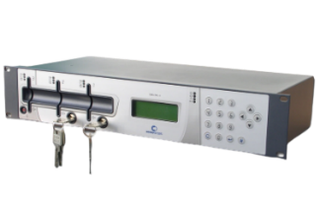
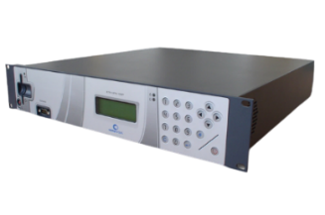
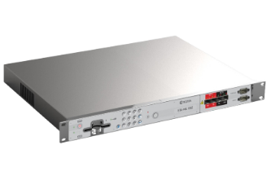
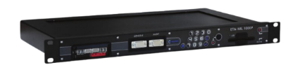
2. KEY PRODUCTS AND MARKETS
PRODUCT PORTFOLIO
CLASSIFIED SYSTEMS „CONFIDENTIAL” AND „RESTRICTED” CLAUSE - ENCRYPTORS
As part of the activity supporting the protection of classified information according to the Act of 5 August 2010 on the Protection of Classified Information, ENIGMA SOI creates devices, systems and solutions with various confidentiality clauses. The Company specializes in counselling, trainings and assistance in the processes of appointing and creating divisions of classified information protection in the companies.
Classified systems „CONFIDENTIAL” clause
Classified systems „RESTRICTED” clause
CompCrypt ETA-MIL 1000P
CompCrypt DELTA 1
CompCrypt ETA-VPN 100P
CompCrypt ETA-MIL 100Z
The ETA-MIL 1000P provides secure interconnectivity over wide area of untrusted IP networks (WANs), enabling the formation of protected virtual private networks (VPNs). Authentication of cryptographic sessions between devices is done using PKI infrastructure and X.509 certificates. Cryptographic keys to protect confidentiality and integrity of data transmission channels are agreed automatically. The devices can be used in both military and civilian systems.
It is a device intended for secure storage and use of a private key of a Certification Authority in PKI infrastructure. It is intended to be used in extensive IT networks with hierarchically complex and territorially dispersed structure. The device increases efficiency and security of information exchange in classified networks, e.g. in government administration systems, banking and telecommunications systems.
It enables the creation of secure separate VPN (Virtual Private Networks). CompCrypt ETA VPN 100P encryptor ensures secure communication between workstations, systems or local area networks (LAN).
The solution is designed primarily for government entities processing and transmitting information between their locations in accordance with the Classified Information Protection Act.
CompCrypt ETA-MIL 100 Z provides information security in IP networks. The solution together with the full external infrastructure - HSM devices, management and audit software, creates a cryptographic complete security platform. The encryptors use a data-plane architecture to provide high performance and minimal latency associated with encrypting and forwarding IP traffic. As a result, the encryptors have high performance (up to 6 Gbit) and allow the transfer of a very high number of packets per second (up to 3 Mpps).

Slide 14
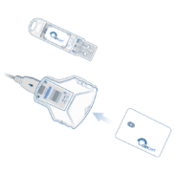



2. KEY PRODUCTS AND MARKETS
PRODUCT PORTFOLIO
QUALIFIED CERTIFICATES - PUBLIC KEY INFRASTRUCTURE
Qualified Electronic Signature
Secure e-mail system
Modules
Modules
KryptoMail-Arch
KryptoMail Serwer
PEM-HEART Aplet
PEM-HEART API
PEM-HEART GUI
Encard Virtual
KryptoMail-C
PEM-HEART Signature software is a tool for implementing the advanced functions of the Cencert secure electronic signature in the Public Key Infrastructure. The software enables the creation and verification of electronic signatures for qualified Certification Centres. PEM-HEART offers a standard set of services for cryptographically securing messages, i.e. message integrity protection, author authentication and non-repudiation of sending provided by secure electronic signature and confidentiality. It verifies signatures issued by all qualified Key Certification Centres.
A modular software package used to protect the confidentiality and authenticity of information sent in an e-mail system based on strong cryptographic mechanisms. The use of electronic signature in the system allows to obtain integrity and authenticity of all information with simultaneous verification of the sender's identity. Thanks to this, only the sender and the indicated recipients have access to the content of the message. The implementation of e-mail protection is done without changing the user's habits. Depending on the required security level, the system is protected by a password or a chip card.
BENEFITS
A modern, secure and convenient way to sign documents (electronic files)
Confirmation of the sender's reliability (identity identification)
Guaranteeing data integrity and confidentiality
Easy verification of changes made to signed documents
BENEFITS
Confirming the authenticity of the sender and recipient in electronic correspondence
Quick and secure way of transmitting important information
Protection against unauthorised reading and use
Protection against electronic attacks and spam

Slide 15
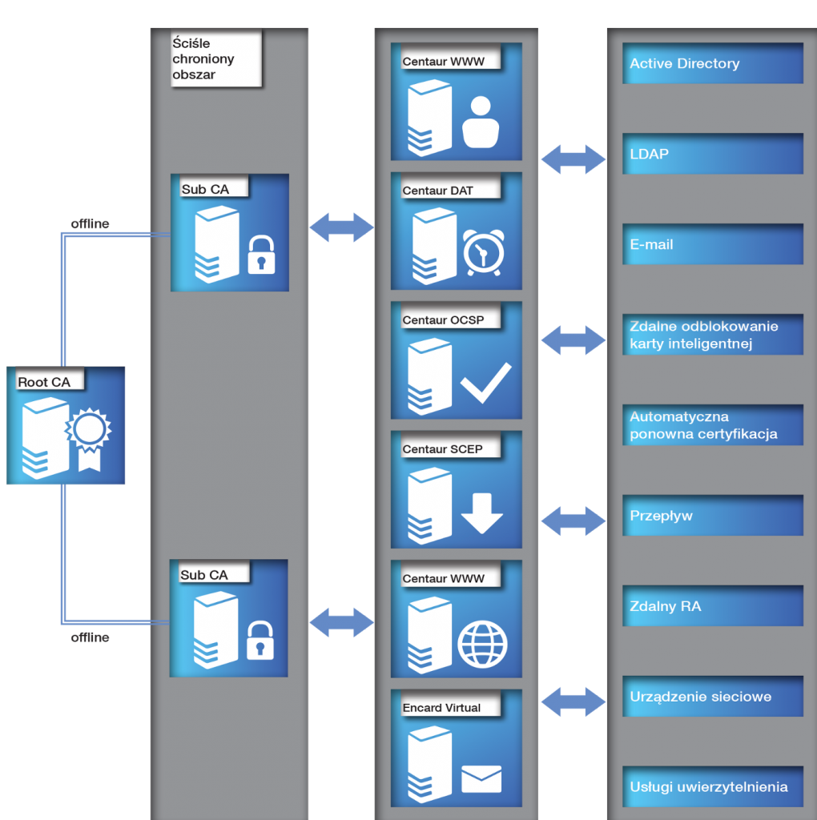
2. KEY PRODUCTS AND MARKETS
PRODUCT PORTFOLIO
PROPRIETARY SOFTWARE LICENCES - PUBLIC KEY INFRASTRUCTURE – CENTAUR and PEM-HEART
Public Key Infrastructure (PKI) - a system supporting secure exchange of electronic data. It ensures integrity, confidentiality and non-repudiation of content in electronic communication. Thanks to the use of PKI, the user of e.g. electronic mail has a guaranteed authenticity of the sender and integrity of the transmitted data, as well as protection against unauthorised reading.
Modular PKI platform - Centaur
Modules
Strictly
protected area
Active Directory
Centaur CCK
Centaur PR
Centaur OCSP
Centaur DAT
Centaur SCEP
Centaur WWW
LDAP
Centaur
Family of solutions provides organisations with a scalable and secure environment. Individual software modules can be used to build systems for generating, distributing and revoking public keys, differing in functionality, security level and implementation costs.
Centaur platform runs on the most popular and strongly secured hardware for storing cryptographic keys of Certification Authorities and users. It allows the creation of any number of Certification Authorities (CAs), with a complex structure and hierarchy.
The main idea behind the solution is to combine the highest level of security with convenience of use. Users do not have to remember to renew their certification or worry about data encrypted with old keys - they will be hidden in the background. Users also do not have to search for the remaining user keys - they will receive them. There is also a choice of desktop or mobile versions of the solution.
E-mail
Remote unlocking of a smart card
Automatic re-certification
Data flow
Remote RA
FUNCTIONALITIES
issuing of certificates and keys
time-stamping
Encard Virtual - a cryptographic card without a physical carrier
BENEFITS
securing important data against loss of confidentiality
controlling user access to systems and applications
ensuring compliance with legal requirements
Network device
Authentication
services

Slide 16
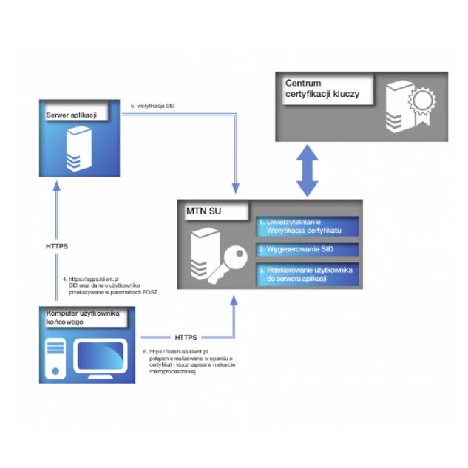
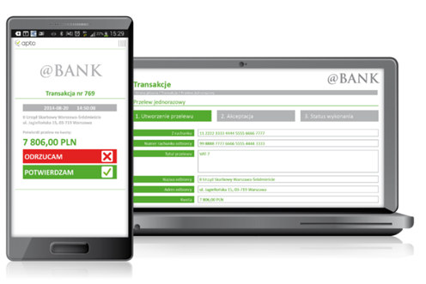
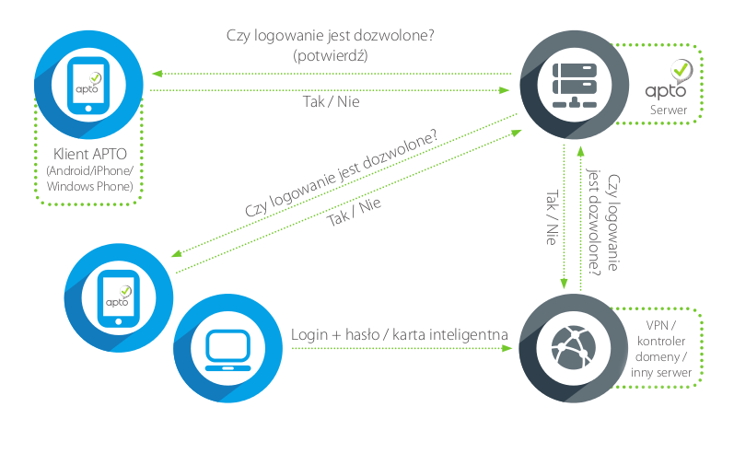
2. KEY PRODUCTS AND MARKETS
PRODUCT PORTFOLIO
PROPRIETARY SOFTWARE LICENCES - ACCESS SECURITY – APTO and SLASH A3
APTO - Two-channel authentication system
SLASH A3 – CENTRAL AUTHENTICATION SYSTEM
Application server
Key
certification centre
Is logging in allowed?
5. SID verification
Yes / No
Apto Client
(Android / iPhone / Windows)
Is logging in allowed?
MTN SU
1. Authentication
Certificate verification
Is logging in allowed?
Yes / No
Yes / No
2. SID Generation
4. SID and user data passed in the POST parameter
3. Redirecting the user to the application server
Login + password / smart card
VPN / other server
End User computer
6. Connection based on a certificate and a key stored in a microchip card
APTO - an innovative platform for authentication and authorisation:
convenience of use with high security, based on a two-factor authentication model,
mechanisms of mobile operating systems,
PKI technology.
APTO is a program installed on a mobile device and used to confirm any ordered operations. Thanks to the use of PKI, it is fully secure and resistant even to technically advanced attacks. It prevents unauthorised access to protected resources. At the same time, it easily integrates with systems and applications operating in companies.
Slash A3 - solution playing the role of a universal authentication server. It uses various methods for the confirmation of user’s identity, e.g. Single-Sign On. As a source of authentication information, it may use many types of databases and external servers such as Radius, Kerberos, SSL/TLS etc. Due to the built-in http/https server and the application of a script language (Lua), it makes it possible to create interactive websites supporting the process of authentication using certificates.
BENEFITS
centralisation of the management of user’s accounts in systems and applications
centralisation of the management of entitlements for each user
management of user’s roles in the systems
possibility to define an official path in the scope of confirmation of entitlements by superiors
verification of the granted entitlements in terms of their safety and validity
huge analytical and reporting opportunities
An example of the use of APTO is to strengthen the security of access to critical company resources by integrating with the organisation's existing VPN solution or to increase the security of performed payment transactions by integrating with the bank's transaction system.

Slide 17




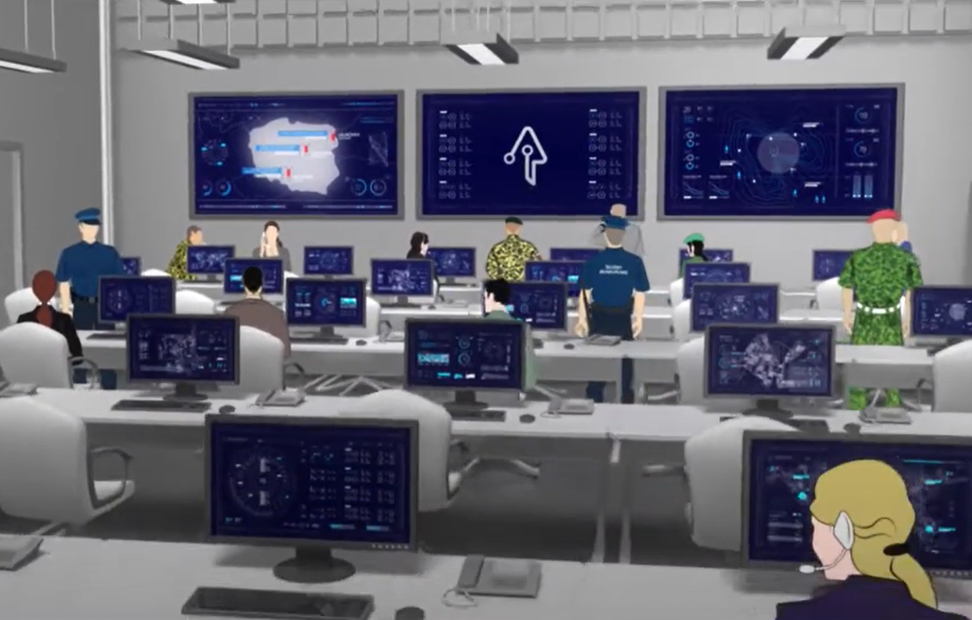







2. KEY PRODUCTS AND MARKETS
PRODUCT PORTFOLIO
PROPRIETARY SOFTWARE LICENCES – CRYSIS MANAGEMENT SYSTEM - AVISPON
AVISPON
Crysis centre
Outside centre
Avispon Client
Task team management
Reports and analytics
Activity Planning
Meeting registration
Standard letters
Facility management
Operation room of the emergency centre
Avispon Video Client
Co-operation with Video Surveillance Solutions
Avispon Mobile Client
Avispon Mobile Map Client
Mobile Application - Tablet, Smartphone
Safe communication
Co-operation with Video-Wall Solutions
Avispon Client
Mobile application - laptop
Avispon Resource Management
Resource Management
Personnel management
Central system
Avispon Server
Avispon Map Server
Avispon Video Server
Avispon Videoconference Server
Avispon Videoconference
Video Conferencing Module
Browser-based application for access from anywhere
Avispon Map Client
Tactical Map
Operational Map
Deployment of forces and resources
Allowed servers and layers
Remote Access to Data
Advanced system created with a view to support a group of professionals engaged in investigating criminal cases and other police-related events. The system is used in the case of occurrence of any crisis situation in an institution, failures of various type and scale, threat for the managed infrastructure, environment, employees or population, as well as in the case of image or information crises. The system contains scenarios for reacting to particular crisis situations, sets of audit recommendations, good practices, and regulations used in handling incidents, as well as human and equipment resources, detailed maps of key areas and facilities speciﬁc for the given company. Flexible scenarios can be redefined during the crisis, depending on how the situation develops.
The system uses mechanisms based on the GIS to position events, resources, and facilities on a tactical map. It offers the ability of working with or even controlling CCTV and mobile camera systems, has a built-in videoconference module for groups, teams, and external consultants, with the possibility of sharing resources (desktop, ﬁles, images and documents). High level of security is guaranteed by the possibility of controlling authorisations based on roles performed in the team dealing with the given incident, integration with an authentication system based on Active Directory, and integration with e-signature systems.

Slide 18
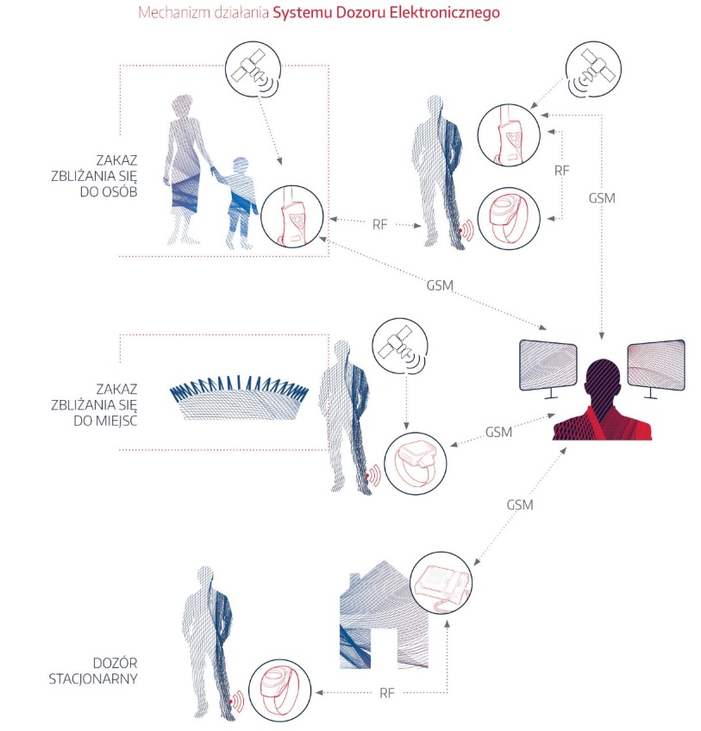
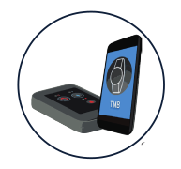
2. KEY PRODUCTS AND MARKETS
PRODUCT PORTFOLIO
PROPRIETARY SOFTWARE LICENCES (EMS ONLY) - ELECTRONIC MONITORING SYSTEM
ELECTRONIC MONITORING SYSTEM
Prohibition on attempting to approach persons
Prohibition on attempting to approach persons
Aplikacja TMB
Prohibition on approaching places
Prohibition on approaching places
The electronic monitoring system is a legal solution present in many countries, which makes it possible to serve a prison sentence or a restriction of liberty outside prison. The necessity of serving the sentence in absolute prison isolation and all the resulting inconveniences has been replaced by the possibility of serving it at home or in another place indicated by the court. The convicted can lead a normal personal, professional and family life under the rigours of full control exercised through a comprehensive electronic monitoring platform by penitentiary units, probation services and authorised supervision institutions.
Stationary surveillance
Stationary surveillance
Each person serving a sentence under the electronic monitoring system is fitted with a transmitting/receiving device, a so-called electronic ring. A monitoring device is installed at the prisoner's place of permanent residence, which enables constant control of compliance with the daily schedule established by the court. Any deviation from the specified schedule is automatically reported to the Monitoring Centre, from where the relevant justice authorities are notified of the offence. Additionally, the device offers the possibility of two-way communication: Monitoring Centre - convict.

Slide 19
2. KEY PRODUCTS AND MARKETS
PRODUCT PORTFOLIO
SERVICES - DEDICATED SOFTWARE – DIGITAL ARCHIVE SYSTEM
Digital Archive System
Data Repository
Role management
PKI
Sharing of archival materials
Archive
Warehouse services
Physical organisation of storage and archive documents
Operation of the digital repository
Archival information description process - introduction of metadata
OCR of documents
Processes of archival material circulation
Recording of employee activities
Archival digitisation processes
Technical processing of archival materials
Preservation work on archival materials
Monitoring, reporting and audits
Reports
Monitoring
Task execution
Operational optimisation
Management information
Audits
External portal - providing information via WWW
The Digital Archive System allows comprehensive management of documents in any form - document images (scanned paper documents), electronic documents (text files, e-mail, multimedia), paper documents and their flow within the organisation.
The system makes it possible to record and group documents into sets, series/subseries and classify them as single objects. Thanks to its internal architecture, it enables to create links between documents and stored objects. Rights in the system are based on roles, which enables flexible creation of rights. Depending on the rights, the user interface is dynamically changed, displaying the options available to the person holding a given right.
Thanks to the PKI implementation, it guarantees security and invariability of stored and shared archives, as well as full accountability of employees.

Slide 20
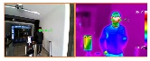




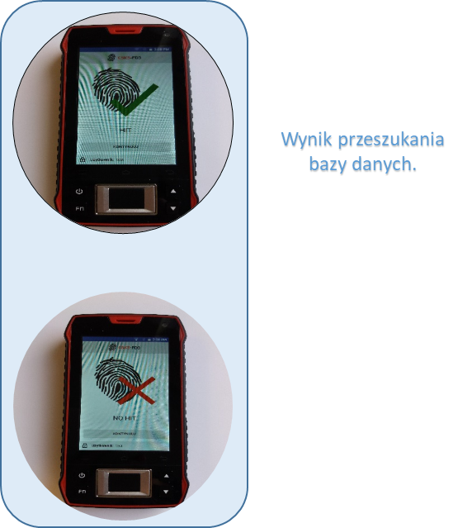
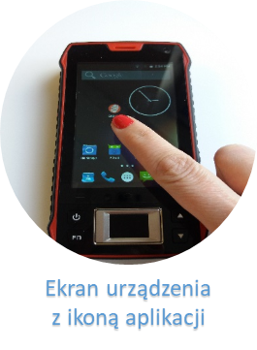
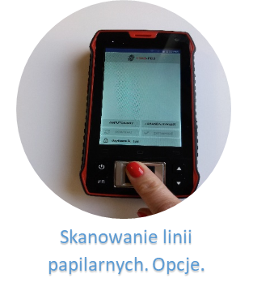
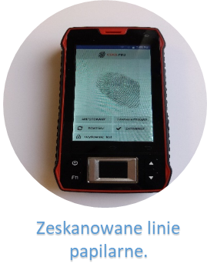
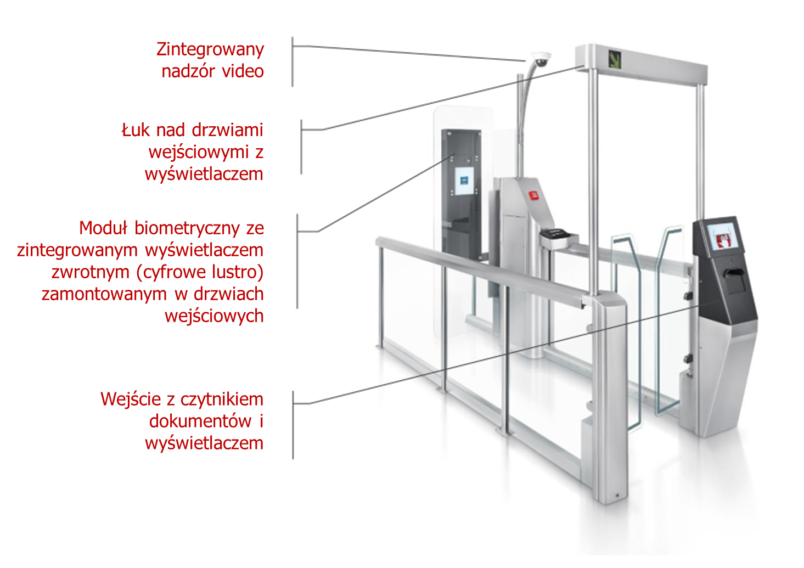
2. KEY PRODUCTS AND MARKETS
PRODUCT PORTFOLIO
SERVICES - DEDICATED SOFTWARE – BIOMETRIC SOLUTIONS
OTHER DEDICATED SOLUTIONS
ABC Airport Security Gates – development of documentation and modification of gates software by ENIGMA
Fingerprint Scanners
Image Analysis
Thermovision
Electronic surveillance system (security of company employees over large areas).
Electric car sharing system for individual and commercial users.
E-Classified Office.
CentaurOne telecommunication data retention system.
Mobile cameras (Getac).
Special vehicles - mobile multipurpose solutions.
Portable terminals.
Industrial cameras and vision systems (Genetec).
Services, training, consulting, penetration tests, audits, projects.
Integrated video surveillance
Arched doorway with display
Biometric module with integrated surface display (digital mirror) mounted on the entrance door
Entrance with document reader and display

Slide 21







2. KEY PRODUCTS AND MARKETS
PRODUCT PORTFOLIO
THIRD-PARTY LICENCES - ACCESS SECURITY – IDM
IDM – IDENTITY MANAGEMENT SYSTEMS
Upon employment in the company, each employee obtains a virtual identity which includes appropriate entitlements in IT systems, related to the position occupied, tasks and competencies in the organisation. The Identity Management solutions in relation to users allow to perform routine monitoring of user’s entitlements in all systems of the institution, which translates not only into the increased data safety, but also into the ordered and simplified processes related to user’s entitlements.
BENEFITS
routine monitoring of user’s entitlements at all levels
centralisation of user’s accounts in all applications and systems – simplified procedures
management of user’s roles in systems
defining an official path in the scope of confirmation of entitlements by superiors
possibility to automatically and preliminarily grant entitlements based on the method of comparison with a group of employees from the same process
wide analytical and reporting opportunities
management of privileged accounts

Slide 22


2. KEY PRODUCTS AND MARKETS
KEY SECTORS FOR ENIGMA
PUBLIC ADMINISTRATION
Name of the entity: Ministry of Justice
Subject of the project: Maintenance and development of the Electronic Surveillance System
Year: 2018-2022
Value of the project: 96.6 PLNm gross
Brief description: Under the contract obtained as a result of winning a public tender, Enigma delivered and launched a comprehensive ICT system for conducting electronic supervision of persons sentenced to imprisonment at home. The scope of the project included: start-up of a dedicated datacenter, modification and servicing of software managing the system, delivery and servicing of devices used for monitoring of convicts, training and consultancy. The Electronic Supervision System, together with the Central Database of Persons Imprisoned, constitute the entire penitentiary system in Poland. The project is implemented by a consortium of companies: Enigma - consortium leader, EBS, ITM Poland, Impel Monitoring.
Name of entity: Ministry of Finance
Subject of the project: Infrastructure for Etoll - supply of hardware and software together with technical support for the SPOE solution (Electronic Toll Collection System - Etoll)
Year: 2020-2022
Value of the project: 70 PLNm gross
Brief description: Deliveries of over 70 servers, deliveries and expansion of Hitachi F1500 and H800 arrays, deliveries of 20 LAN switches including 100Gbit class LAN switches, deliveries of 100Gbit line cards, deliveries of SAN switches. The subject of the contract includes deliveries of Enterprise-class security systems including: LAN and WAN firewalls, WAF and load balancers.

Slide 23



2. KEY PRODUCTS AND MARKETS
KEY SECTORS FOR ENIGMA
PUBLIC ADMINISTRATION - PROJECTS
Name of the entity: Social Insurance Institution (ZUS)
Subject of the project: Migration of digital identity management system - ZTC
Year: 2020-2021
Value of the project: 26.8 PLNm gross
Brief description: The project includes the delivery of Hardware and licenses as part of the CMS Migration and the execution of the CMS Migration. As part of the Identity Management System Migration, Enigma implemented Single Sign On (SSO) tools from Microfocus. Additionally, Enigma implemented a PKI system for the Identity Management System. The project covers over 50,000 users. Consortium of companies Comp, Enigma.
Name of the entity: Court of Appeal, Wrocław
Subject of the project: Common Courts Information Portal
Year: 2018-2022
Value of the project: 10 PLNm gross
Brief description: Implementation of the Common Courts Information Portal within the project "implementation of electronic protocol in common courts (civil and misdemeanour cases)". The Common Courts Information Portal is a service of access to information on the status of cases and actions taken in a case, which is contained in the software supporting the court office in cases heard before common courts. As part of the project, an Electronic Submission Office will be created, enabling common court users to submit documents in electronic form.
The aim of launching the portal was to facilitate access to information for authorised and entitled entities, in particular parties to proceedings and their attorneys as well as judges and prosecutors. 374 Common Courts serviced, 30,000 external users daily, 10,000 internal users daily, 4 months - time of taking over the service from the previous Contractor and building a new solution, 3 mobile applications for Android, iOS and Windows systems.
During the contract, the Court commissioned more than 15,000 hours of portal development work. (e.g. the e-Delivery module). Consortium of Enigma and S&T Services Polska Sp. z o.o.
Name of the entity: Government Strategic Reserve Agency
Subject of the project: Building a secure information transmission system
Year: 2021-now
Value of the project: >1 PLNm net
Brief description: The project included the supply of IP encryptors, hardware and software for the construction of a system for secure transmission of "confidential" information. The project also included a complete service of supply and implementation of IP encryption devices in RARS facilities in Poland.
The implemented equipment and software were covered by support and maintenance services for a period of 60 months.

Slide 24

2. KEY PRODUCTS AND MARKETS
KEY SECTORS FOR ENIGMA
PUBLIC ADMINISTRATION - PROJECTS
Name of the entity: NASK National Research Institute
Subject of the project: NASK OSE: Network behaviour monitoring system called System B3
Year: Implementation 02-09.2021, until 2026 guarantee and development
Value of the project: >20 PLNm net
Brief description: The contract is implemented by Enigma with the participation of subcontractors AiSECLAB and Freeconstruction. According to the provisions of the Act on the National Educational Network of 27 October 2017, as amended, the primary task of OSE is to provide educational units in Poland with the possibility of protected access to secure Internet and educational resources. In order to ensure the highest possible level of security in the use of OSE resources and the Internet, Enigma launched the Network Behaviour Monitoring System in 17 nodes of the OSE network, aimed at detecting threats related to cyberbullying (stalking, harassment, aggression, humiliation), access to harmful content (pornography, violence, content inciting self-harm or suicide, discriminatory content), sexting, etc. The system makes it possible to monitor and analyse children and young people's online behaviour and to identify the school from which a given transmission is made. This means monitoring traffic passing through Regional Security Nodes.
The system is built from a central analytical system and probes that collect network traffic at the RWB level. The data collected from the probes are then pre-processed, additionally annotated with system metadata and sent in an encrypted form to the central analytical system, whose task is to automatically analyse the collected data, monitor events and notify in real time in the event of detecting threats related to the use of the Internet. A scoring analysis was used to detect words and expressions with negative emotional overtones, based on pre-prepared dictionaries of terms related to pornography, cyberbullying, self-aggression, sexting, sextortion, child grooming, hate speech, with other harmful content. Advanced artificial intelligence methods using self-learning algorithms are used to recognise the content of the images.
The System collects information including addresses of visited websites; however, no personal data is collected that would allow for identification of the student subject to the analysis, but only information allowing for identification of the school to which notification of a potential threat will be sent.

Slide 25


2. KEY PRODUCTS AND MARKETS
KEY SECTORS FOR ENIGMA
UNIFORMED SERVICES
Name of the entity: Police
Subject of the project: Supply of a body-worn camera system for police units
Year: 2018, 2020
Value of the project: 11.4 PLNm net (2018), 19.5 PLNm net (2020)
Brief description: Supply of 2110 (in 2018) and additional 3100 (in 2020) body-worn cameras along with software and IT equipment (PC stations, servers, matrices, switches) for 31 Police units in 2018, and 70 units in 2020.
The project included a complete service of implementation of the system in designated locations together with training for users. The implemented system was covered by support and maintenance services for 36 months.
Name of entity: Border Guard
Subject of the project: Entry/Exit System (EES) - Biometric identification for foreigners
Year: 2021
Value of the project: 16.5 PLNm net
Brief description: Delivery of 108 biometric registration devices for foreigners (persons arriving from outside the Schengen area) - basic order with option right and extension of the order by another 108 devices. The project included the delivery of ready-made biometric registration devices for the Entry/Exit System with documentation and software for sending biometric data to the Border Guard border clearance system. The supplied equipment was covered by support and maintenance services for a period of 62 months.

Slide 26

2. KEY PRODUCTS AND MARKETS
KEY SECTORS FOR ENIGMA
UNIFORMED SERVICES - PROJECTS
Name of the entity: Armed Forces Cyber Resource Centre (Centrum Zasobów Cyberprzestrzeni Sił Zbrojnych)
Subject of the project: Extension of the cryptographic system
Year: 2018-now
Value of the project: 45.8 PLNm net
Brief description: The project covered the supply of IP encryption devices as well as equipment and software for the expansion of the PKI infrastructure.
The project included a complete service of supply and implementation of IP encryption devices in the cryptographic system of MON, as well as the supply and implementation of devices and software for the expansion of the PKI MON system.
The implemented equipment and software were covered by support and maintenance services for a period of 48 months. The system was realised on the basis of products: Enigma - ciphers and software, Thales - HSM devices, F5 - traffic balancing system, CISCO - network elements The project was implemented by a consortium of companies: Enigma - consortium leader, COMP
Name of the entity: Police
Subject of the project: Delivery of mobile terminals
Year: 2021
Value of the project: 2 PLNm net
Brief description: Supply of specialised mobile devices acting as Mobile Wearable Terminals.
The project included the delivery of devices together with management software (MDM). The devices were covered by support and maintenance services for a period of 60 months.

Slide 27


2. KEY PRODUCTS AND MARKETS
KEY SECTORS FOR ENIGMA
UNIFORMED SERVICES - PROJECTS
Name of the entity: Military Historical Office
Subject of the project: Construction of a digital archive for the Central Military Archives
Year: 2018-now
Value of the project: >7 PLNm gross
Brief description: Supply of specialised mobile devices acting as Mobile Wearable Terminals.
The project included the delivery of devices together with management software (MDM). The devices were covered by support and maintenance services for a period of 60 months.
Name of the entity: Armed Forces Cyber Resource Centre (Centrum Zasobów Cyberprzestrzeni Sił Zbrojnych)
Subject of the project: Delivery and development of 3DC system (three-centre reliability cluster)
Year: 2020-obecnie
Value of the project: >15 PLNm net
Brief description: The project included the delivery and expansion of the existing 3DC system to a Private Cloud Computing system. The project included a complete delivery and implementation service of hardware and software to extend the 3DC system into a PRO form. As part of the project, design and technical documentation was developed on the basis of which a full implementation of the supplied solutions was carried out, ensuring operation of the system in the PRO form. The implemented equipment and software within the system were covered by support and maintenance services until September 2022.

Slide 28


2. KEY PRODUCTS AND MARKETS
KEY SECTORS FOR ENIGMA
UNIFORMED SERVICES - PROJECTS
Name of the entity: Border Guard
Subject of the project: Equipment for automated border/passport control, so-called "ABC gates".
Year: 2018
Value of the project: 5.5 PLNm net
Brief description: Delivery of 20 ABC Gates at Okęcie Airport and 5 ABC Gates at Modlin Airport.
The project included a complete service of implementation of ABC Gates at Okęcie and Modlin airports along with development of documentation and adjustment of ABC gates software to connect with the Border Guard border clearance system.
The implemented ABC Gates were covered by a support and maintenance service for a period of 62 months. In 2019-2021, Enigma delivered further ABC Gates in the number of 25 units for airports located in the cities of: Poznan, Wroclaw, Krakow. The total value of the deliveries amounted to over 20 PLNm gross.
Name of the entity: Armed Forces Cyber Resource Centre (Centrum Zasobów Cyberprzestrzeni Sił Zbrojnych)
Subject of the project: Support for Central Backup System
Year: 2021-2024
Value of the project: 13.5 PLNm net
Brief description: The support service covers hardware and software forming the CSB installed in centres in Poland. Training services are also provided as part of the project.
The service will be implemented for a period of 36 months.

Slide 29


2. KEY PRODUCTS AND MARKETS
KEY SECTORS FOR ENIGMA
FINANCIAL INSTITUTIONS
Name of the entity: Societe Generale
Subject of the project: APTO
Year: 2015-2021
Value of the project: 300 PLNk net
Brief description: Proprietary solution produced by Enigma for two-factor authentication of operations, in particular for logging in and confirming transactions in electronic banking systems for corporate clients.
Name of entity: KIR and selected banks in Poland
Subject of the project: Hardware protection of cryptographic keys for ELIXIR
Year: 2016-now
Value of the project: >1 PLNm net
Brief description: Starting in 2016, Enigma has provided and maintained HSM (hardware key protection modems) infrastructure for over a dozen of the largest users of the Elixir system. Elixir is an electronic system of interbank settlements enabling efficient execution of transfers in PLN, the volume of which in 2021 amounted to almost 200 million operations, for a total amount of approximately 700 PLNbn. The use of HSM significantly increases the level of security and efficiency of the service.
KIR has chosen Enigma because of the highest on the Polish market competence in the field of general-purpose HSM and a unique way of organising maintenance services, allowing the fastest execution of repairs on the basis of a round-the-clock on-call team and the possessed service slope. KIR is a technology hub, a key player in the infrastructure of the Polish payment system and a provider of digital solutions for banking, economy and administration, providing services which effectively and efficiently increase the level of digitalisation of processes, both in the commercial sphere, mainly in banking, and in public administration.

Slide 30


2. KEY PRODUCTS AND MARKETS
KEY SECTORS FOR ENIGMA
TELECOMMUNICATIONS
Name of the entity: Orange Polska S.A.
Subject of the project: Migration of Orange PKI to Centaur
Year: 2014-now
Value of the project: 2.6 PLNm net
Brief description: The contract covered the delivery, installation, configuration, implementation, testing and commissioning of Centaur PKI family proprietary Software, migration of data from PKI infrastructure (from UniCERT Baltimore products), as well as warranty for the implemented Software and software development services (adjustment to the Ordering Party's environment, including the user identity management and authentication layer). The work performed enabled uninterrupted use of public key solutions in the corporate infrastructure on Windows servers and in services provided commercially to external customers. The licence currently covers 35,000 users (corporate and collaborative) and the solution has been migrated to Linux class servers. The agreement is a framework agreement under which deliveries of products supporting the PKI solution are also made, including equipment for the implementation of the enterprise Central HSM, authentication tokens, licences and support for security software.
Name of entity: Netia S.A.
Subject of the project: Netia Oracle IDM
Year: 2019-now
Value of the project: >750 PLNk net
Brief description: Based on Oracle IAM, Enigma is gradually implementing a user identity management solution for Netia S.A., which enables the migration to a single solution of functionalities previously dispersed across several dedicated systems, while enabling cyclic attestation and certification of authorisations through a single consistent user interface. Netia, now in the Cyfrowy Polsat Group, is one of the leading Polish telecommunications operators, and has been a customer of Enigma's solutions for nearly 10 years, including the dedicated, proprietary INDICO data retention system.

Slide 31


2. KEY PRODUCTS AND MARKETS
KEY SECTORS FOR ENIGMA
MANUFACTURING, TRANSPORT AND ENERGY
Name of the entity: PKP Intercity SA
Subject of the project: Implementation of the Workflow System
Year: 2019-2020
Value of the project: >5 PLNm gross
Brief description: Delivery and implementation of a system and hardware platform along with licenses for the Workflow system and automation of selected business processes of the Employer. As part of the project, the Oracle BMPN system was delivered, on the basis of which the process of railway ticket complaints was automated. The system supports all supported channels of ticket returns and automatically sets up and distributes cases to company employees, ensuring their equal occupancy. In addition, the solution has mechanisms for automatic calculation of the refund due together with generation of the content of an appropriate letter with the basis for calculation of the refund. The system also verifies the legitimacy of each refund in other systems used by the company, including the reservation system, vehicle location system, etc.
Name of the entity: Warsaw Trams (Tramwaje Warszawskie sp. z o.o.)
Subject of the project: Integrated Information System of EAM/CMMS class
Year: 2021-obecnie
Value of the project: 11.9 PLNm gross
Brief description: Delivery and implementation of the EAM / CMMS (Enterprise Asset Management / Computerised Maintenance Management System) class Asset Management system. The scope of implementation of the system includes the processes of execution of transport tasks and maintenance and management of the rolling stock. The system will be used in all 4 of the company's plants and as an option in the newly built plant No. 5 in Annopol. Warsaw Trams is the most developed tram system in Poland. Each day, nearly 400 tram brigades (i.e. cars running in trains or individually) travel on the capital's tracks, covering over 4 million kilometres per month.

Slide 32


2. KEY PRODUCTS AND MARKETS
KEY SECTORS FOR ENIGMA
MANUFACTURING, TRANSPORT AND ENERGY
Name of the entity: Energa - Operator S.A.
Subject of the project: Vehicle monitoring with GPS solution
Year: implementation 2020-2021, until 2023 guarantee and development
Value of the project: 2.3 PLNm net
Brief description: The contract is executed by a consortium of Enigma (Leader) and ITM Poland S.A. (main technical contractor) is to deliver and start up a system to monitor and manage a fleet of 2000 vehicles with the use of GPS technology. The consortium will provide and implement the GPS System software on the Employer's IT infrastructure and provide the required licences for the GPS System software, equip 2000 vehicles with GPS and provide 700 specialised sensors and probes, provide licences for the Mobile Application for the Employer's employees' smartphones, ensure integration of the GPS System with existing systems, provide training to administrators and end users of the GPS System, and provide the Ordering Party with warranty service and development services for a period of 24 months.
Name of the entity: PKP Polskie Linie Kolejowe SA - Railway Guard
Subject of the project: Interactive Database of Railway Traffic Guards
Year: 2019-2023
Value of the project: 10 PLNm net
Brief description: As a result of the 2018-2019 public open tender procedure, Enigma, despite an appeal to the KIO by its main competitor SPIRINT S.A., was awarded the contract for the supply of a licence and implementation of the ready-to-use proprietary software AVISPON. The software has been parameterised and configured according to the Employer's requirements, the contract includes the supply and installation of a highly available multi-node hardware and system infrastructure necessary for the launch and operation of the Railway Guard Interactive Database.
The solution will enable full management of all processes in the service of approx. 1000 officers, completion of all tasks and selected processes of communication with internal systems of the company and public administration. The system is expected to reach 100% functionality by September 2022 after the SOK completes the mobile terminals on which guards are to work in the field.

Slide 33


2. KEY PRODUCTS AND MARKETS
KEY SECTORS FOR ENIGMA
MANUFACTURING, TRANSPORT AND ENERGY AND MEDIA
Name of entity: PKP Intercity SA
Subject of the project: Planning system implementation
Year: 2018-2021
Value of the project: >8 PLNm gross
Brief description: Delivery, implementation and maintenance of a system for planning, optimising and accounting for the work of trains and conductors as well as the circulation of rolling stock. The system includes automatic generation of both services and optimal monthly schedules in terms of the boundary conditions set by the user. One of the elements of the system is the employee portal, thanks to which the company staff has access to their schedules, working time accounts, service progress for a given day and can notify the dispatcher of any deviations from the plan. More than 3,500 company employees are scheduled to work in the system. In 2020, the carrier had a 12.75% market share measured in terms of passenger numbers (3rd in the country) and a 48.6% market share measured in terms of transport work measured in passenger-kilometres (1st in the country).
Name of the entity: TVN S.A.
Subject of the project: VTE Thales - encryption system
Year: 2021
Value of the project: 90 EURk net
Brief description: Supply and implementation of Thales' Vormetric Transparent Encryption (VTE) solution. Data/file encryption in the operating system, access control and privileged user access policies, context encryption without file renaming, encryption on production..

Slide 34
Introductory information
Legal information
Group structure
Financial overview
Operational summary
Key clients
Product portfolio overview
History
Key products and markets
Products and services portfolio
Enigma SOI key sectors and segments
Intellectual Property
Intellectual property documentary evidence
Research & Development projects
Human resources
Management team
Human resources, key competences & experience
Clients and business partners

Slide 35
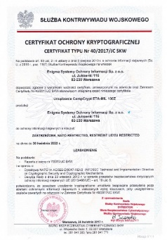
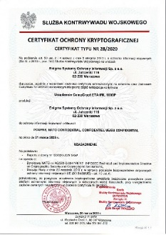
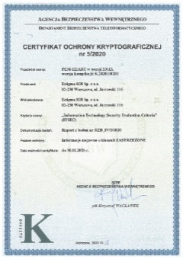
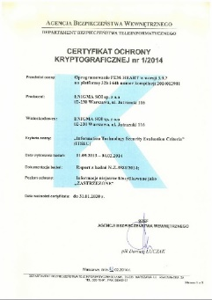
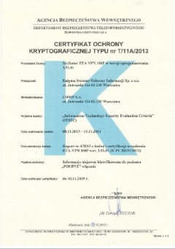
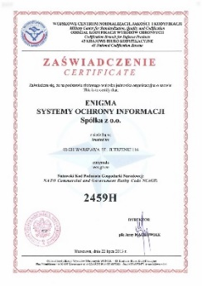
3. INTELLECTUAL PROPERTY
INTELECTUAL PROPERTY DOCUMENTARY EVIDENCE
LICENSES
CompCrypt ETA-MIL 100Z
Certificate for the protection of information classified as restricted,
NATO Restricted, EU Restricted.
CompCrypt ETA-MIL 100Z
Certificate for the protection of information classified as confidential,
NATO Confidential, EU Confidential
PEM-HEART 3.9.13
Certificate for software PEM-HEART 3.9.13 for protection of classified information constituting professional secrecy marked with "restricted" clause.
PEM-HEART 3.9.7
Certificate for the PEM-HEART 3.9.7 software designed for the protection of classified information constituting a trade secret rated as “Restricted”.
CompCrypt ETA-VPN 100P IP
Certificate for the CompCrypt ETA-VPN 100P cryptographic device with the 3.51.05 version operating system, issued by the Department of ICT Security of the Internal Security Agency, to the company COMP, sold by Enigma.
NATO Commercial and Government Entity Code (NCAGE)
On 22 June 2013, the Military Centre for Standardization, Quality and Codification awarded Enigma Information Security Systems Sp. z o.o. the NATO Commercial and Government Entity Code NCAGE: 2459H.

Slide 36
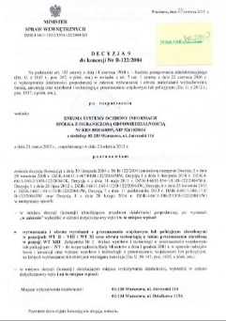
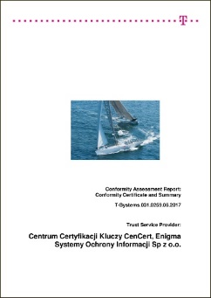
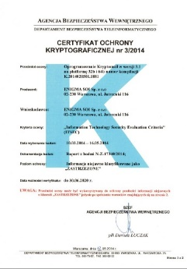
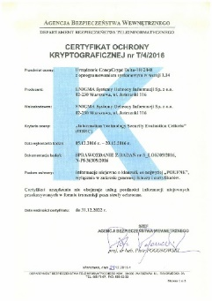
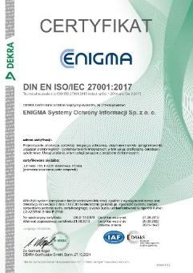
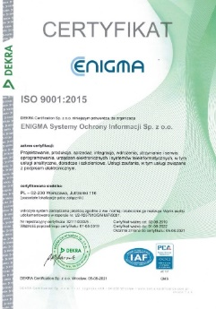
3. INTELLECTUAL PROPERTY
INTELECTUAL PROPERTY DOCUMENTARY EVIDENCE
LICENSES
Certificate for Qualified Certification Centre Cencert.
An eIDAS audit entitles a qualified entity to provide services in respect of:
issuing qualified certificates for qualified electronic signatures,
issuing qualified certificates for qualified electronic seals,
issuing qualified time stamps.
License of the Ministry of Internal Affairs
License of the Ministry of Internal Affairs for the production and marketing of products for military or police use specified in sections WTII-VIII, WT XI, and WT XIII.
Kryptomail
Certificate for the Kryptomail software designed for the protection of classified information constituting a trade secret rated as “Restricted”.
Certificate for CompCrypt Delta-1R/2048
cryptographic device for the protection of information classified CONFIDENTIAL.
ISO 9001:2015
Certification for: Development, integration, implementation, maintenance and service of information systems and software, including analytical, consulting, training services. Certification services related to electronic signature. Design, manufacture, sale and service of electronic devices and cryptographic systems.
ISO IEC 27001
Certificate DIN EN ISO/IEC 27001:2017

Slide 37
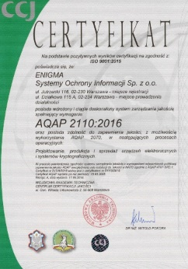
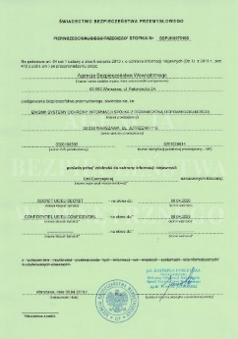
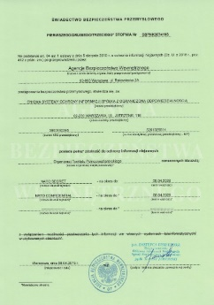

3. INTELLECTUAL PROPERTY
INTELECTUAL PROPERTY DOCUMENTARY EVIDENCE
LICENSES
1st degree Industrial Safety Certificate (EU)
First level Industrial Security Certificate No.. SBPUK007519S to ensure protection of classified information with the security clause "SECRET EU" and with the security clause "CONFIDENTIAL EU"
AQAP 2110:2016
Certification for Enigma SOI covering the design, manufacture and sale of electronic devices and cryptographic systems..
1st degree Industrial Safety Certificate (NATO)
First level Industrial Security Certificate No. SBPNK007419S to ensure protection of classified information with the security clause "NATO SECRET" and with the security clause "NATO CONFIDENTIAL"
1st degree Industrial Safety Certificate
First level Industrial Security Certificate No.. SBPKK007319T to ensure protection of classified information with the security clause "SECRET" and with the security clause "CONFIDENTIAL"

Slide 38
3. INTELLECTUAL PROPERTY
RESEARCH & DEVELOPMENT PROJECTS
KEY RESERCH & DEVELOPMENT PIPELINE
Work on the implementation of the NINE and SCIP protocols in encryptors constructed by Enigma. NINE and SCIP protocols are communication standards used in NATO and will become the standard for national military communication systems in the near future.
Development work aiming to improve and extend the functionality of equipment and software used to build Electronic Monitoring System (including Electronic Supervision of Prisoners). Historically, Enigma participated in the construction of the first system of this kind in Poland in 2009 (the total value of that project, including services, amounted to over 150 PLNm), followed by a smaller system in Italy (the system was launched in 2014), and currently, as of 2018, the Company is implementing the next (third) edition of the project in Poland, which will last until October 2022 and whose value brings, including expansion, 90 PLNm. Enigma is making efforts to offer such systems worldwide, taking part in tender proceedings, presentations and talks among others in South American, Asian and European countries.
Development work to extend the functionality and introduce new solutions in the Centaur software family, including adapting the software offered to the requirements of RODO. Centaur is software created, developed and offered by Enigma for over 25 years. It is used, among others, by the National Bank of Poland, a number of Ministries (Interior, National Defence, Finance, Justice), many government offices and agencies, uniformed services (e.g. Police) as well as by many commercial customers.

Slide 39
3. INTELLECTUAL PROPERTY
RESEARCH & DEVELOPMENT PROJECTS
KEY RESERCH & DEVELOPMENT PIPELINE
PemHeart software is historically Enigma's second longest running solution. It has found a number of applications with customers from the uniformed, special, central administration as well as finance and banking markets. Currently, the most popular application of PemHeart is in the installations of the Ministry of Foreign Affairs and in the national system of Crisis Communication managed by the RCB (which is used by several hundred national institutions, including offices, services, etc.). Developed PemHeart elements are also used by CenCert customers (tens of thousands of installations).
Development work, complementing the functionality of one of Enigma's own products (as part of this work, version v2 of the Avispon solution is being developed). This link has been used in projects for the Central Bureau of Investigation of the Police and the Military Police, in the Railway Protection Service and currently, on its basis, a large system is being developed for the GITD. Potential next users of this product are uniformed services or formations operating within the uniformed services, crisis management units, and investors managing large, complex projects (e.g. construction of dams, power plants, etc.).
Development works concerning one of the families of encryptors offered by Enigma. The latest version of the device has been offered since 2018, and the revenues that Enigma has achieved so far from its sales have exceeded 50 PLNm. The R&D work currently underway concerns standard changes and modifications to the device to ensure its reliable and secure operation.
39

Slide 40
3. INTELLECTUAL PROPERTY
RESEARCH & DEVELOPMENT PROJECTS
KEY RESERCH & DEVELOPMENT PIPELINE
Development of system allowing the handling (creation and editing) and completion of questionnaires / surveys of various types, providing functionality for the aggregation of responses. It supports different types of questionnaires (single/multiple choice, rating (e.g. assigning values of 1-10), open, mixed questions...). Moreover, the system allows the overall management of the therapeutic processes, exercise lists (create, edit, delete), data - supports the user's progress and ensures the correct sequence of the designed therapy process. The user's progress is tracked on the basis of a separate record of the exercise performed.
Development of new in-house hardware and system platform, which will enable the creation and certification of several different IP encryptors intended for the protection of national and NATO classified information with various clauses - from the Restricted/NATO Restricted level, up to and including the SECRET level, dedicated to work in various conditions (office / field, stationary / mobile). The new architecture will enable significant miniaturisation, while retaining performance parameters appropriate for server network devices that are several times larger, heavier and consume more power. The project also includes a hardware HSM module providing security for the keys of the PKI authority, integrated with its own PKI solution: Centaur CCK, as well as a comprehensive service providing management and monitoring of the extensive cryptographic system.
Development work on one of the family of encryptors offered by Enigma. The latest version of the ETA 1000P device has been offered since 2020, and the revenue Enigma has so far generated from its sales exceeded 5 PLNm. The R&D work currently underway concerns standard changes and modifications to the device to ensure its reliable and secure operation.

Slide 41
Introductory information
Legal information
Group structure
Financial overview
Operational summary
Key clients
Product portfolio overview
History
Key products and markets
Products and services portfolio
Enigma SOI key sectors and segments
Intellectual Property
Intellectual property documentary evidence
Research & Development projects
Human resources
Management team
Human resources, key competences & experience
Clients and business partners

Slide 42
4. HUMAN RESOURCES
MANAGEMENT BOARD
LEADERS OF ENIGMA SOI
Paweł Andrzej Luksic
Marek Andrzej Wołoszyn
Marcin Ligenza
Radosław Frydrych
President of the Board
Vice President of the Board
Vice President of the Board
Vice President of the Board
History
History
History
History
1999 - Starts cooperation with COMP S.A.
2006 - Member of the Supervisory Board of Enigma SOI
2007 - Member of the Board of Directors of Enigma SOI
2009 - President of the Management Board of Safe Technologies SA
2012 - President of the Management Board of Enigma SOI
1997 - Beginning of cooperation with COMP S.A.
1997-1999 - SUN Microsystems technology engineer
2002 - Pacomp Sp. z o.o. - conducted research and development of cryptographic devices
2010 - President of the Management Board of Pacomp Sp. z o.o.
2011 - Member of the Management Board of Enigma SOI
2012 - after the merger of Pacomp, Enigma and Security Division of COMP S.A. he became Vice President of the Board of Directors of Enigma SOI
2005 - Beginning of cooperation with COMP S.A.
2005-2012 - Cryptographic solutions engineer at Pacomp Sp. z o.o. After merging with Enigma SOI, Director of the Embedded Systems Division
2015 - Member of the Board of Enigma SOI
2001 – 2005 - President of the Board of Centrum Doskonalenia Zarządzania
Meritum Sp. z o.o.
2005 - 2014 - President of the Board of Meritum - doradztwo i szkolenia Sp. z o.o.
2007 - Beginning of cooperation with COMP SA - Division Director
2012 - 2014 - Vice President of the Board of Directors of BigVent SA, a company operating within the COMP capital group.
2020 - Member of the Board of Enigma SOI
Experience
Experience
10 years of experience in designing cryptographic solutions and embedded systems
Many years of experience with ETA encryptors
coordination of investment processes and company mergers:
M2Net
Safe Technologies
Pacomp
Security Division COMP S.A.
Experience
Experience
Areas of project management, software production, implementation and maintenance
establishment of Pacomp Sp. z o.o. - the first Polish company of innovative technologies and production of cryptographic devices
Education
Education
Warsaw University of Technology - Automation and Robotics
University of Warsaw - Economics and Management
Warsaw University of Technology - Faculty of Electronics and Information Technology
Education
Education
Warsaw University of Technology - (1988 – 1993)
Świętokrzyska University of Technology - Electrical Engineering Automation and Computer Science

Slide 43
4. HUMAN RESOURCES
ENIGMA RESPONSIBILITY LEVELS
ORGANIZATION OF THE COMPANY - FOUR RESPONSIBILITY LEVELS
Management Board (MB)
Responsible for definition of Company’s long term strategy
Supervising business strategy and its expansion in departments.
Organizational strategy, ensuring operational effectiveness and implementing new solutions to improve the company value.
Developing and implementing new service development strategies, marketing and internal communication and innovation process support and coordination.
Department Managers (DM)
The definition and execution of the strategy in the sectors.
Sales process management, team development.
Identifies business opportunities and participates in sales process.
Business Unit Managers (BUM)
Responsible for the sales process (clients acquisition and relationships).
Project portfolio management and delivery in the full scope of the IT project cycle (from design to maintenance).
Back-office
Supports MB, DM and BUM with back-office activities including marketing, controlling, HR and administration.

Slide 44
4. HUMAN RESOURCES
KEY COMPETENCES OF ENIGMA
BROAD COMPETENCES OF THE ENIGMA HUMAN RESOURCES ARE PROVEN BY NUMEROUS CERTIFICATES CONSIDERING TEAMS’ COMPUTER SCIENCE AND MANAGEMENT SKILLS
ENIGMA has a team of over 300 highly qualified people with advanced technological and project management competences confirmed by numerous certificates.
The team has proven its ability to manage IT project both in and outside of Poland.
ENIGMA has implemented a content process of evaluation of team's competences and its development through internal and external trainings programme.
ENIGMA is prepared to work in various models with the clients, depending on its requirements.
ENIGMA has extensive experience in the full scope of the specialised IT project life cycle (analysis, design, configuration, customization, implementation, integration, testing, administration, maintenance, development).
ENIGMA has competences within the full spectrum of technologies: from the hardware to the application layer.
ENIGMA team has experience confirmed by success stories of working with important government bodies, as well as large corporations and organizations (blue chips).

Slide 45


4. HUMAN RESOURCES
NATO CERTIFICATES
OVER 140 EMPLOYEES WITH AUTHORIZATION TO ACCESS CLASSIFIED INFORMATION OF NATO AND EU ON DIFFERENT ACCESS LEVELS
4
Top secret access, including NATO-Top Secret, EU-Top Secret
People
60
Secret access, including NATO-Secret: 52 people, EU-Secret: 48 people
People
114
Confidential access, including NATO-Confidential: 53 people, EU-Confidential: 49 people
People

Slide 46
4. HUMAN RESOURCES
EMPLOYEE GEOGRAPHICAL DISTRIBUTION
ENIGMA WORKS IN FOUR LOCATIONS ACROSS TWO CITIES IN POLAND
ca. 10
Warsaw Headquarters
ca. 215
CenCert Keys Certification Center
Employees
Employees
CenCert maintenance and implementation team
Sales
Project Management
Accounting
Controlling
Software production
Sales support
WARSAW
WROCLAW
ca.20
Cryptographic Equipment Manufacturing Plant
ca.70
Wrocław Subsidiary
Employees
Employees
Equipment design and software development
Security division
Design
Manufacturing and service of equipment (including Electronic Surveillance and Crypto)
Due to COVID-19 pandemic no. of employees in each loocation may differ slightly because of remote work possibilities
| 59

Slide 47
4. HUMAN RESOURCES
GROWING CAPACITY OF ENIGMA (NO. OF EMPLOYEES)
NO OF EMPLOYEES
+30.38%
+13.94%
Decrease due to promotions
NA
Note: *levels designated for IT-related positions

Slide 48
Introductory information
Legal information
Group structure
Financial overview
Operational summary
Key clients
Product portfolio overview
History
Key products and markets
Products and services portfolio
Enigma SOI key sectors and segments
Intellectual Property
Intellectual property documentary evidence
Research & Development projects
Human resources
Management team
Human resources, key competences & experience
Clients and business partners

Slide 49












































































5. CLIENTS AND BUSINESS PARTNERS
KEY RESOURCES OF ENIGMA SOI
CUSTOMER VALUE – EXTENSIVE PRIME CLIENT PORTFOLIO
Telecoms, financial institutions, business
Transportation. logistics
Gov bodies
Energy, resources
Ministries
Gov related entities

Slide 50



















5. CLIENTS AND BUSINESS PARTNERS
KEY RESOURCES OF ENIGMA SOI
PARTNERS’ VALUE – LONG-TERM COOPERATION NETWORK

Slide 51

Contact Information
Enigma Information Security Systems LLC
Jutrzenki 116, 02-230 Warsaw

